Slide 1
User Friendly Data Filing Solution

Slide 2
Presentation flow
Introduction to Hans AMS
Hans AMS: Benefits and Features
Overview: Hans Infomatic

Slide 3
Advance Manifest System: Overview
Automated system to file shipment data electronically to ICEGATE
Security enabled with Digital Signatures
Facility to generate Delivery Orders
View Positive and Negative acknowledgements in the system
Automate data processing through XML, Text file, Excel and IATA messaging
IGM/ EGM, Air Consol (CGM) and Sea Consol Filing

Slide 4
All in One User Interface
Airlines
Freight Forwarders
Sea line

Slide 5
Enabling efficient and effective filing
Compliance ready
User friendly and simple data keying facility
MIS Reports
24X7 Helpline

Slide 6
Delivering business success
360 degree solutions
Flexible
And Configurable
User friendly data input
Single system
interface
Cloud based technology for 24x7 access
Centrally controlled data mgmnt.

Slide 7
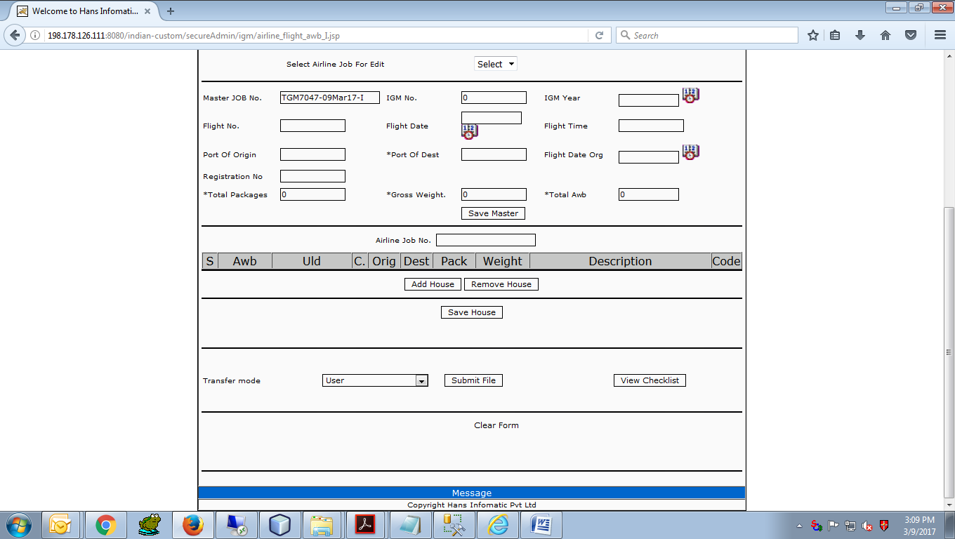
User screens: Airline’s Module Filing AWB and Flight information
Air lines | Freight Forwarders | Sea line

Slide 8
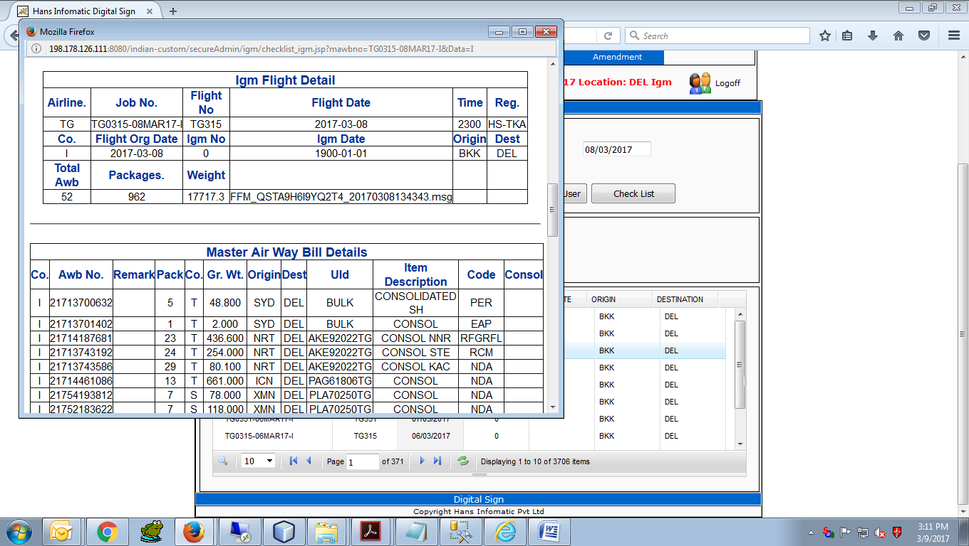
User screens: Airline’s Module Check List
Air lines | Freight Forwarders | Sea line

Slide 9
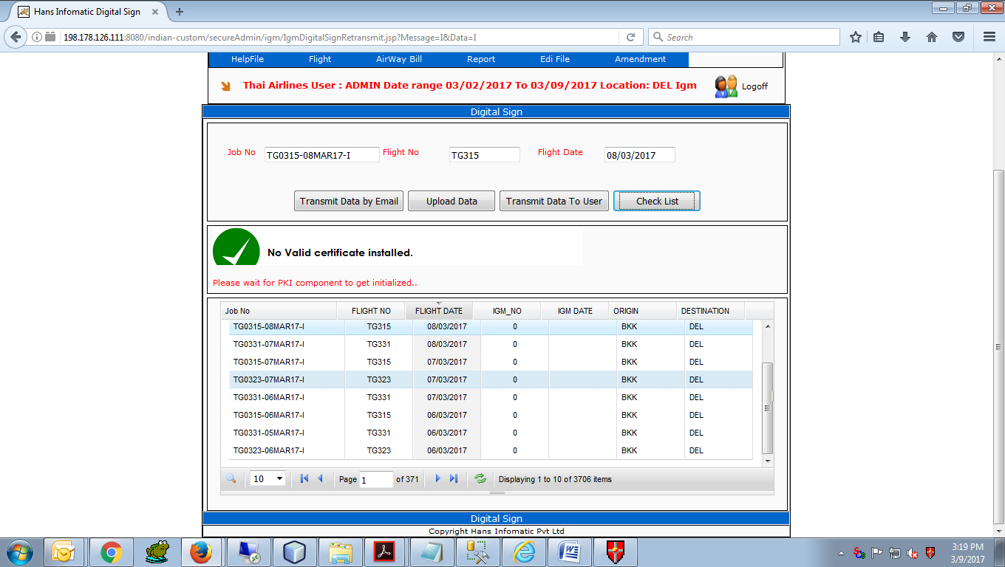
User screens: Airline’s Module Submit to ICEGATE with Digital Signatures
Air lines | Freight Forwarders | Sea line

Slide 10
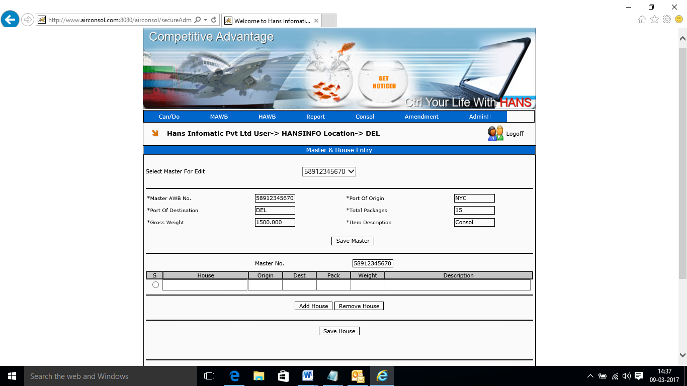
User screens: Freight Forwarder’s Module Master and House AWB Entry
Air lines | Freight Forwarders | Sea line

Slide 11
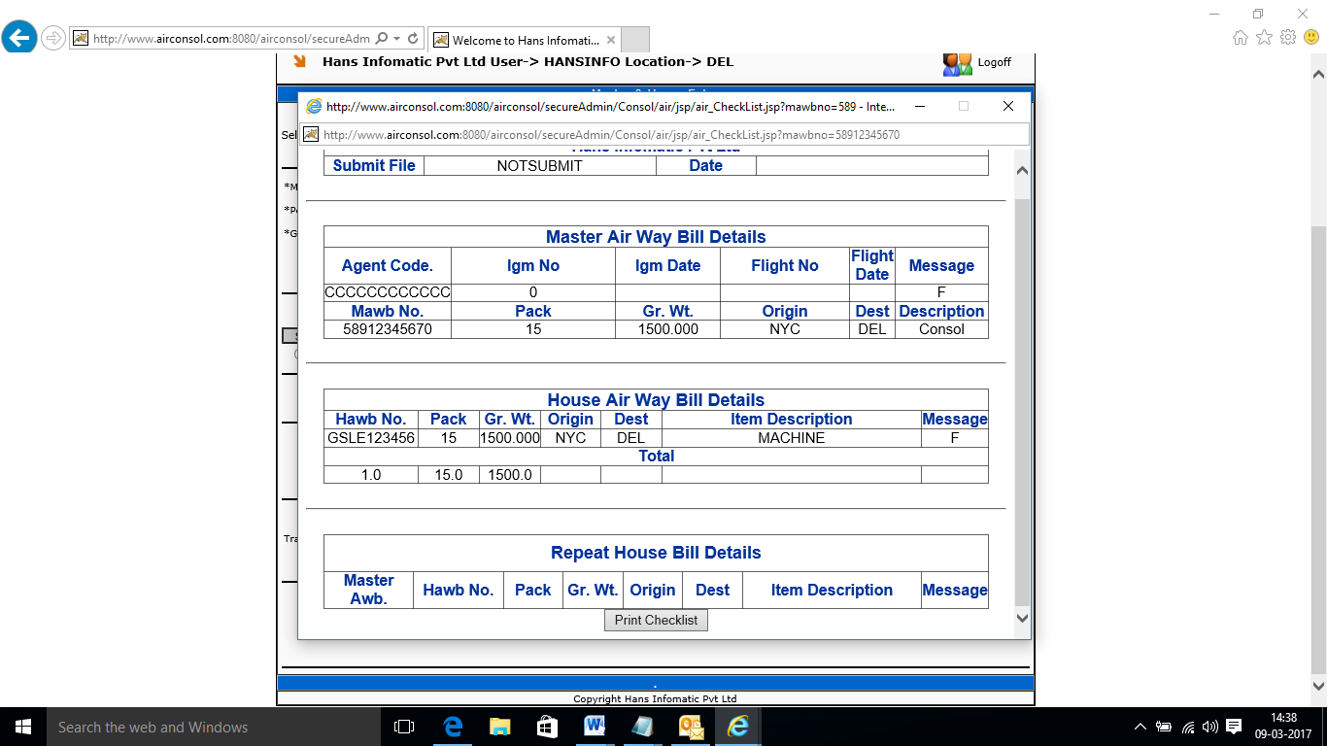
User screens: Freight Forwarder’s Module Checklist
Air lines | Freight Forwarders | Sea line

Slide 12
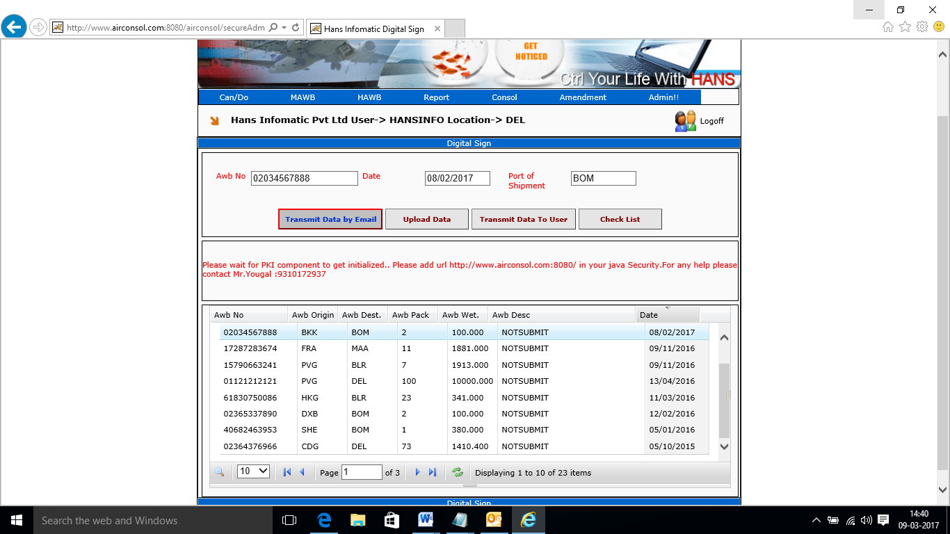
User screens: Freight Forwarder’s Module Submit to ICEGATE with Digital Signatures
Air lines | Freight Forwarders | Sea line

Slide 13
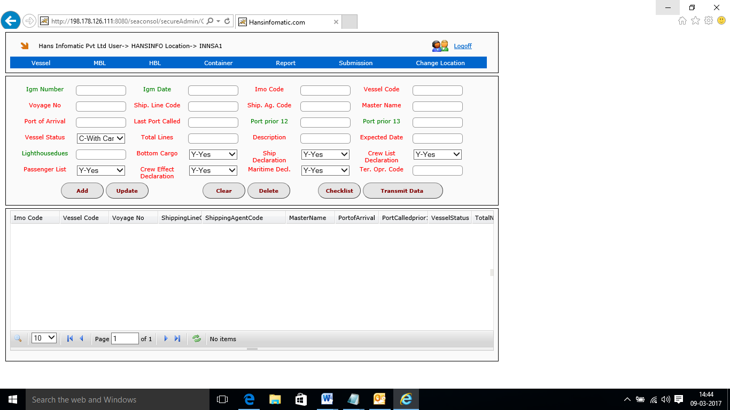
User screens: Sea Line Module Vessel Details
Air lines | Freight Forwarders | Sea line

Slide 14
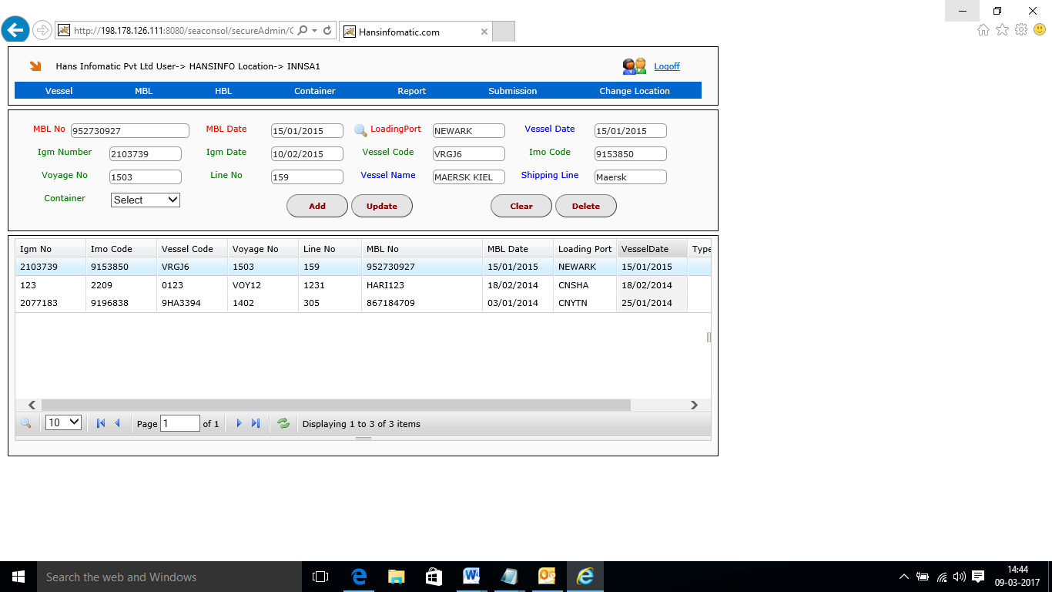
User screens: Sea Line Module MBL Details
Air lines | Freight Forwarders | Sea line

Slide 15
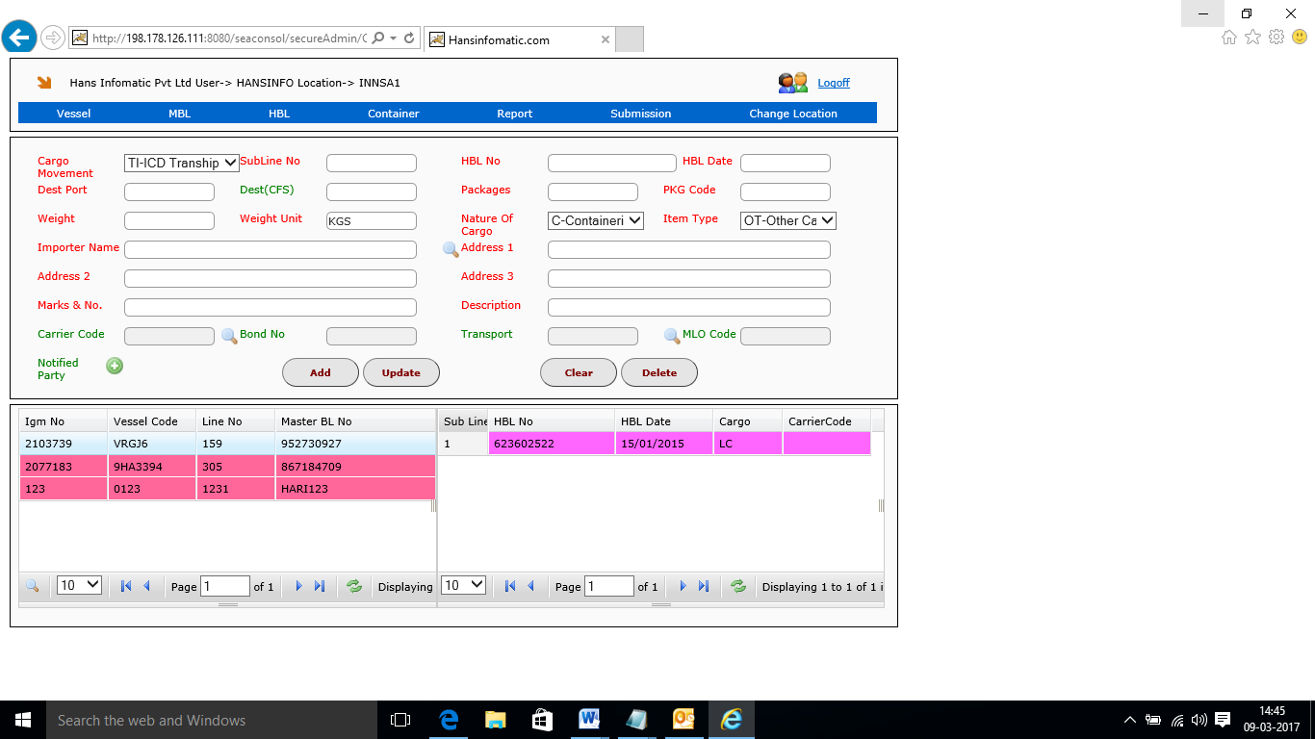
User screens: Sea Line Module HBL Details
Air lines | Freight Forwarders | Sea line

Slide 16
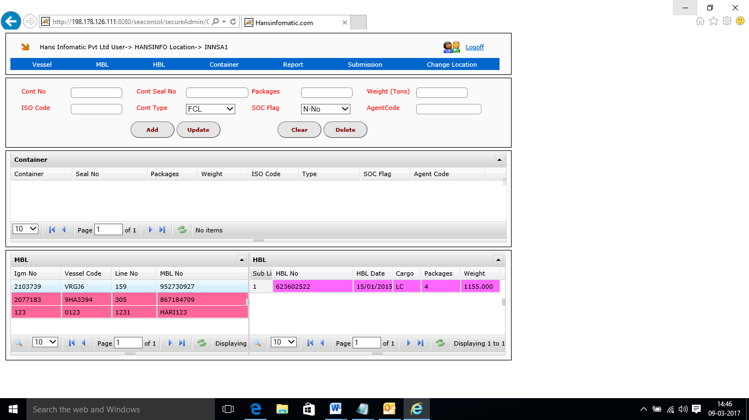
User screens: Sea Line Module Container Details
Air lines | Freight Forwarders | Sea line

Slide 17
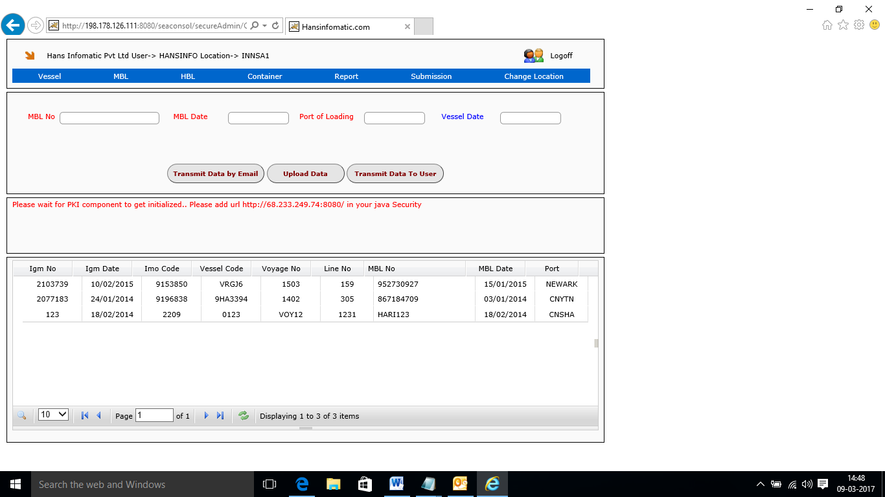
User screens: Sea Line Module Submit to ICEGATE with Digital Signatures
Air lines | Freight Forwarders | Sea line

Slide 18
Key Customers of : Consolidators

Slide 19
Key Customers of : Airlines

Slide 20
Pioneers in Cargo and Logistics solutions in India
Quality solutions, which are robust, cost effective and meet international standards
CMMI Level 3 and ISO certified company
Promoted by software experts with over 25 years domain experience
CONFIDENTIAL.
© Hans Infomatic Pvt. Ltd. 2017.

Slide 21
Hans Infomatic: A Thought Leader
Evolutionary technology
Identifying business challenges and building robust solutions
Domain enriched solutions
Delivering business benefits at an early stage
CONFIDENTIAL.
© Hans Infomatic Pvt. Ltd. 2017.

Slide 22
Hans’ Commitment
Partners to your success
Ahead of time technology
24x7 support and timely updates
Simplify and streamline processes
CONFIDENTIAL.
© Hans Infomatic Pvt. Ltd. 2017.

Slide 23
Key Customers of Hans Infomatic

Slide 24
D 96, Sector 63, NOIDA (Delhi NCR), India 201309
Telephone: +91 120 4514308-22
Mobile: +91-9313338121
Email : sales@hansinfomatic.com
Website: www.hansinfomatic.com

